Slide 1

Comparison of Annual & Casual Riders’ Bike Usage
Presented By- Mohd Faiz
Last Updated On- 31-Jan-2023

Slide 2
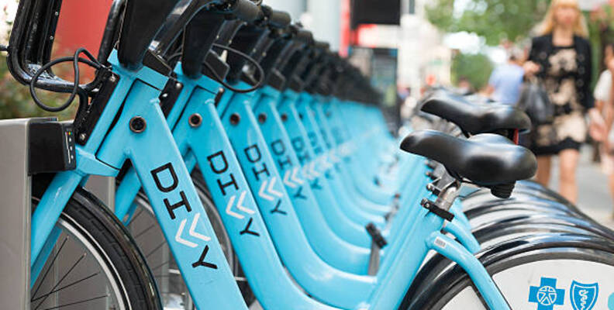
Agenda
Objective
Data Source
Insights
Top 3 Recommendations
References and Contact Info

Slide 3
Objective
To analyze how member riders and casual riders ( having single ride pass or full-day ride pass) use Cyclistic bikes differently in order to determine the best market strategy to convert casual riders into member riders.

Slide 4
Data Source
Cyclistic Bike Trip Data
12 months of historical bike trip data: Jan-2022 through Dec-2022.
The data has been made available by Motivate International Inc. under this license.
Data has been cleaned for anomalies.

Slide 5
Insights
Number of Trips
Total number of Casual and Member Rides >
Total number of rides every month >
Total number of rides each day >
Total number of rides by bike type and members >
Trip Length
The total length of bike usage every month >
The total length of bike usage each day >
Average Ride Length of bike usage every month >
Average Ride Length of bike usage each day >

Slide 6
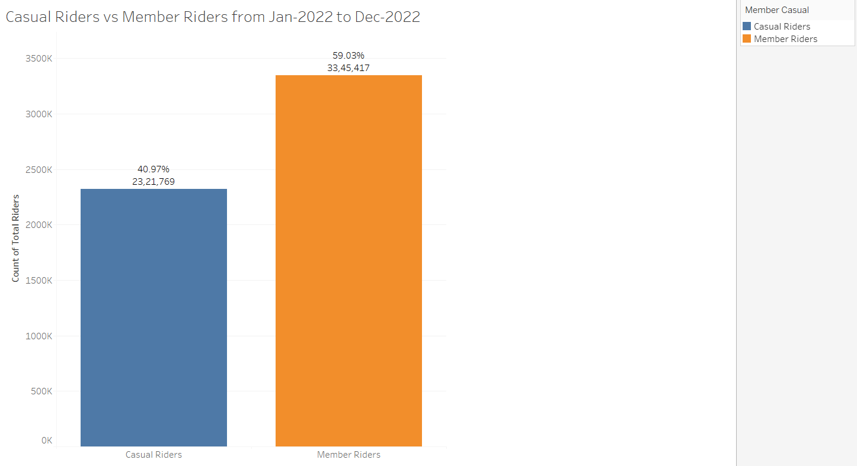
Total number of Casual and Member rides
Key Takeaway:
Member Riders takes most trips overall.
Notes:
Total number of rides taken by casual and member riders and their percentage are shown

Slide 7
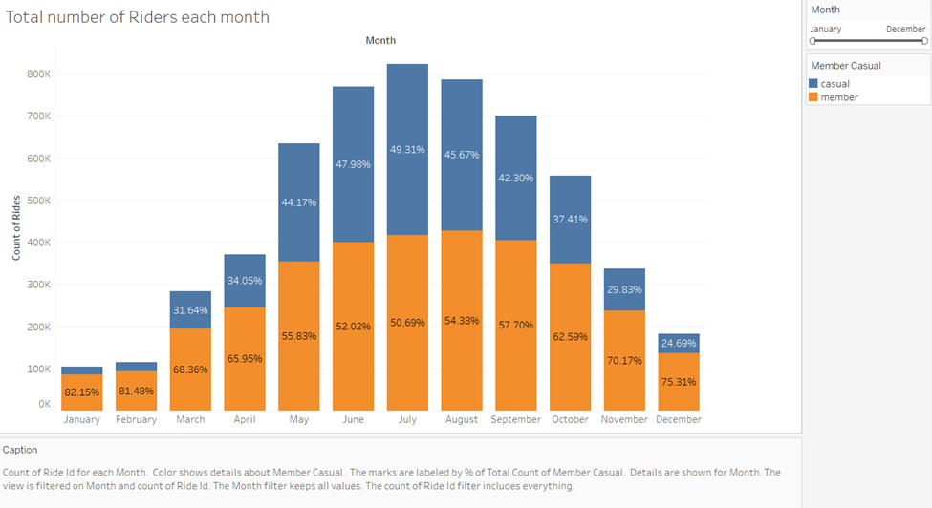
Total number of rides every month
Key Takeaways:
All around the year, we can see that trips taken by member riders are greater than casual riders.
The number of rides taken by both casual and member riders cumulatively increase in the months of May-October.
Casual riders take the least number of trips in the months of Winter, i.e., December, January, and February
Notes:
Total number of rides taken by casual and member riders and their percentage are shown

Slide 8
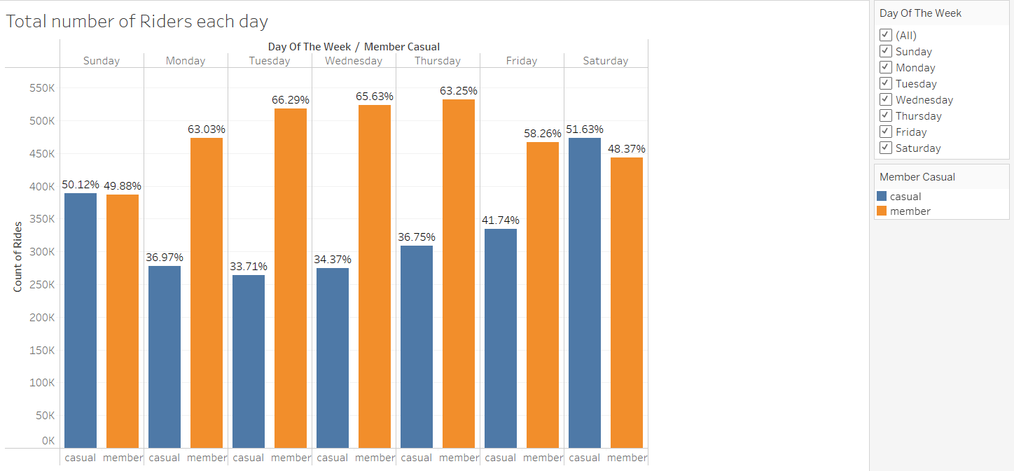
Total number of rides each Day
Key Takeaways:
Member riders mostly ride on weekdays
Casual riders ride more on weekends
Notes:
Total number of rides taken by casual and member riders and their percentage are shown

Slide 9
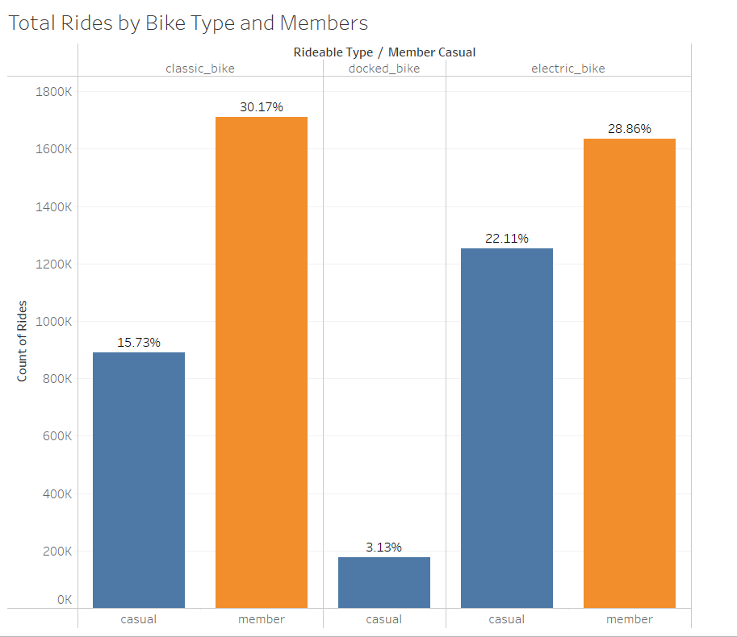
Total number of rides by bike type and members
Key Takeaways:
Both types of riders prefers Electric or Classic bikes.
Member Riders only use a classic and electric bikes.

Slide 10
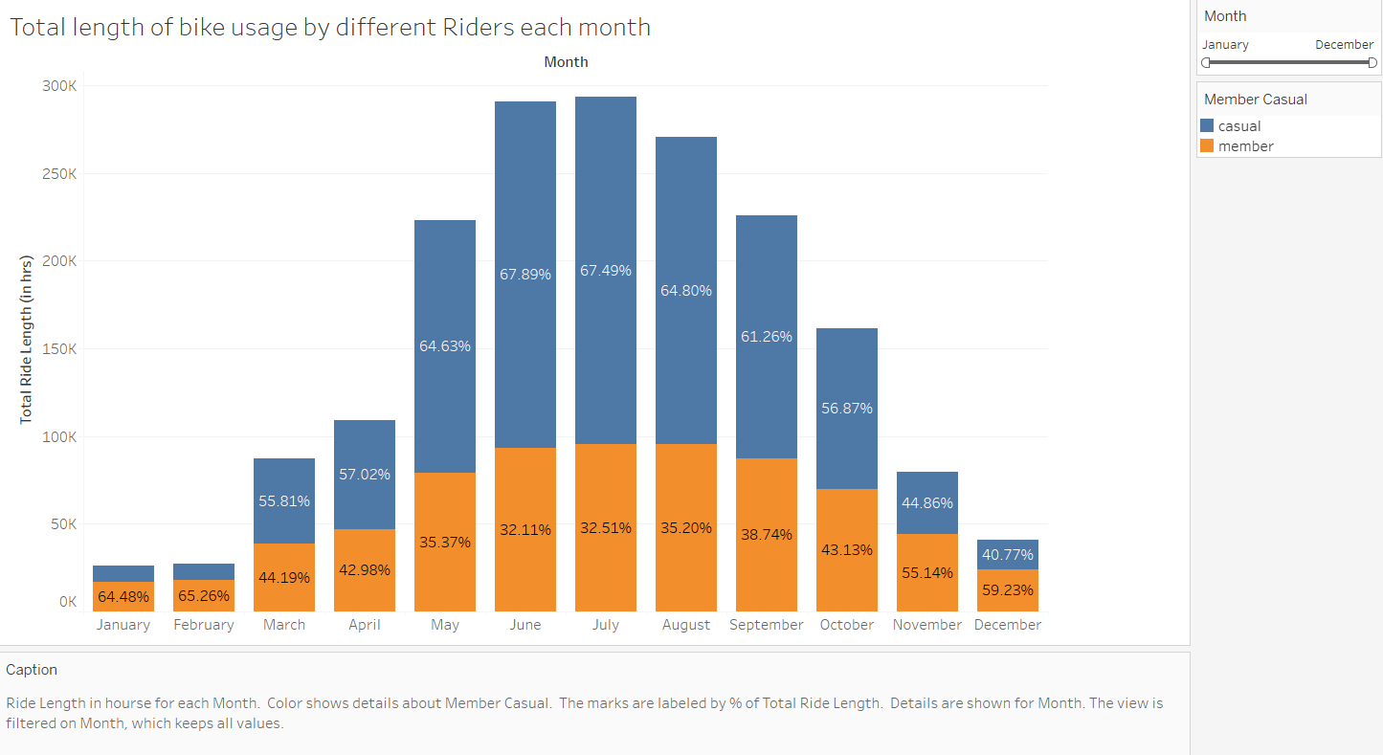
length of bike usage by members and casuals every month
Key Takeaways:
Casual Riders prefer riding bikes for a longer time than member riders
Since there are fewer numbers of casual riders in the months of January, February, November, and December, total trip lengths are also less than member riders.

Slide 11
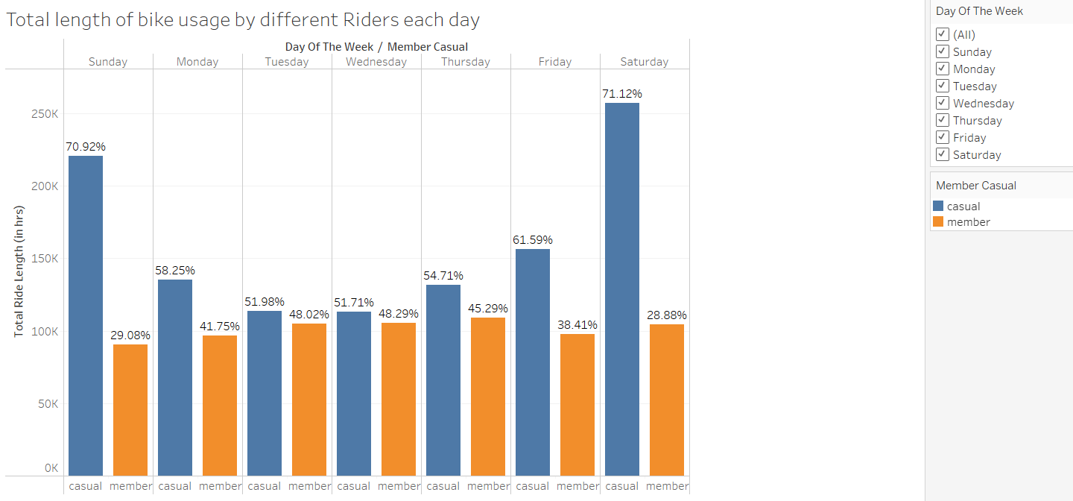
length of bike usage by members and casuals each day
Key Takeaways:
Casual Riders prefer riding bikes for a longer time than member riders every day and this number increases highly on weekends.
Member riders ride less than casual riders on weekends.

Slide 12
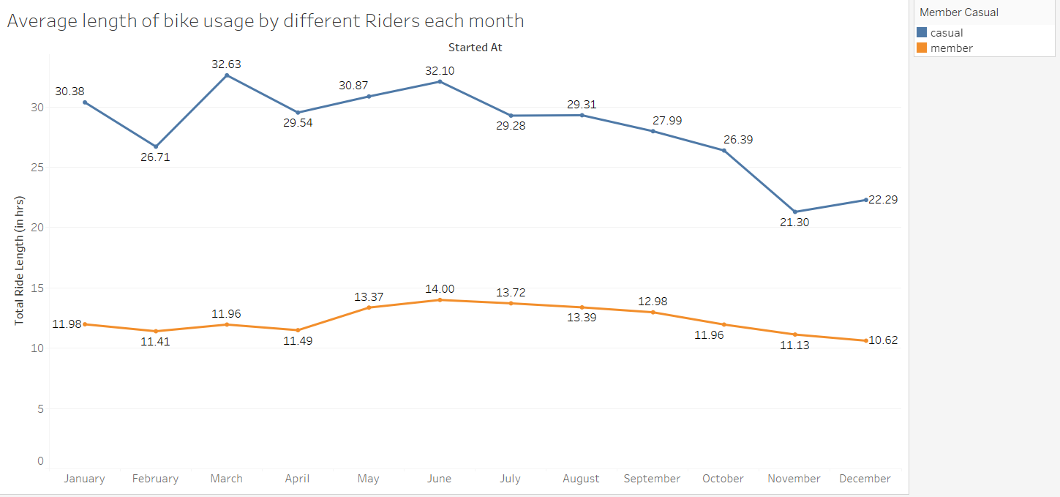
Average length of bike rides every month
Key Takeaways:
As suspected casual riders’ average ride lengths are also greater than member riders every month.

Slide 13
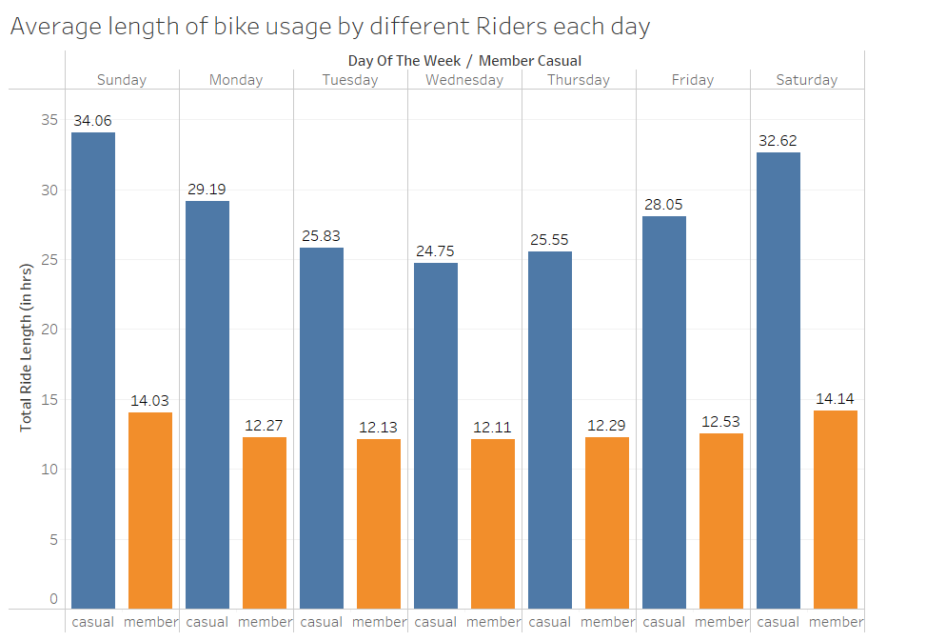
Average length of bike rides each day
Key Takeaways:
Similarly, casual riders’ average ride lengths are also greater than member riders each day.

Slide 14
Top 3 recommendations
An increase in demand by casual riders during Spring and Summer is an opportunity for targeted advertising campaigns and promotional activities.
Launch a casual rider email campaign in early Spring and run through Summer.
Casual riders’ bike use – Increase in weekend activity. Member riders’ bike use – More active mid-week
Create new member packages which are designed for entertainment and weekend activities.
Casual riders prefer cycling for a longer duration while member riders’ rides are of consistent length.
A new member package could also include discounts for riding bikes for a longer time.

Slide 15
Thank You!!

